Slide 1

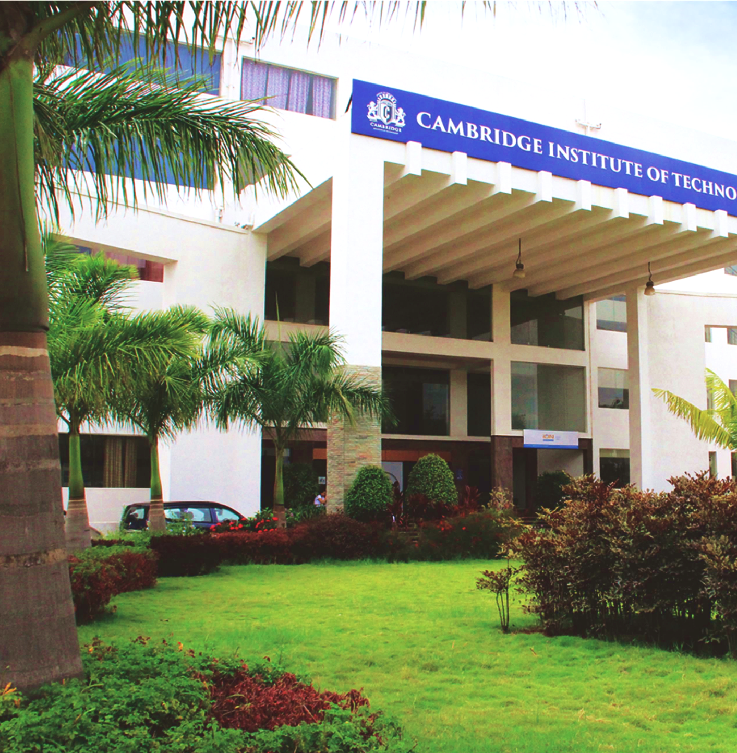
www.cambridge.edu.in
Project Work Phase – I
Subject Code:21AIMP67
Project Name:
Revolutionizing 3D Model Generation with Generative AI
Presented By :
D DEV TARUN 1CD21AI009
D MANOJ 1CD20AI010
Department of Artificial Intelligence and Machine Learning

Slide 2
Problem Statement
" Revolutionizing 3D Model Generation with Generative AI"
Department of Artificial Intelligence and Machine Learning www.Cambridge.edu.in

Slide 3
Abstract
Creating high-quality, diverse 3D models has always been a complex and time-consuming task, essential to industries like gaming, animation, and virtual reality. ShapeGenAI leverages cutting-edge Generative AI to transform this process, enabling the rapid and efficient generation of detailed 3D shapes from simple inputs.Using advanced transformer models, ShapeGenAI enhances both the quality and variety of generated shapes, streamlining workflows and making 3D model creation accessible to everyone, from professionals to hobbyists. By reducing technical barriers and speeding up the modeling process, ShapeGenAI aims to unleash a new wave of creativity and innovation in digital content creation, shaping the future of design and entertainment.
Department of Artificial Intelligence and Machine Learning www.Cambridge.edu.in

Slide 4
Introduction
Introduction to Shap-E
Developed by OpenAI
A framework for generating and understanding 3D shapes using AI
Applications in fields like computer graphics, gaming, and 3D modeling
Why:
To efficiently generate high-quality and diverse 3D models, making 3D design more accessible and enhancing creativity and innovation.
How:
By leveraging advanced transformer models to create detailed 3D shapes from simple inputs, streamlining the 3D modeling process.
Department of Artificial Intelligence and Machine Learning www.Cambridge.edu.in

Slide 5
Applications:
Gaming: Rapid creation of complex 3D characters and environments.
Animation: Streamlined production of high-quality 3D models for animated films and series.
Virtual Reality (VR) and Augmented Reality (AR): Efficient generation of immersive 3D content.
3D Printing: Designing intricate and customized models for manufacturing.
Architecture and Design: Quick prototyping and visualization of buildings and products.
Education: Providing interactive and engaging 3D models for learning purposes.
Healthcare: Creating detailed anatomical models for medical training and simulation.
Department of Artificial Intelligence and Machine Learning www.Cambridge.edu.in

Slide 6
Literature Survey
SL NO | PAPER TITLE | JOURNAL NAME | DESCRIPTION | PROS | CONS
1 | Wu et al.'s "Learning a Probabilistic Latent Space of Object Shapes via 3D Generative-Adversarial Modeling" (2016) | Conference paper | Introduces 3D GANs for generating 3D objects by learning a probabilistic latent space representation. | Allows for the generation of realistic 3D shapes from noise vectors. Captures complex structures and details in 3D objects. | Training can be challenging and requires large datasets and computational resources.
2 | Wu et al.'s "3D ShapeNets: A Deep Representation for Volumetric Shapes" (2015) | Conference on Neural Information Processing Systems (NIPS). | Presents ShapeNets, a framework using deep belief networks for representing and learning 3D shape models from voxel data. | Effective in learning hierarchical representations of 3D shapes. Suitable for volumetric data and capturing detailed shapes. | Voxel-based methods can be memory-intensive and less efficient for large-scale datasets.
Department of Artificial Intelligence and Machine Learning www.Cambridge.edu.in

Slide 7
SL NO | PAPER TITLE | JOURNAL NAME | DESCRIPTION | PROS | CONS
3 | Qi et al.'s "PointNet: Deep Learning on Point Sets for 3D Classification and Segmentation" (2017) | Conference on Computer Vision and Pattern Recognition (CVPR). | Introduces PointNet, a deep neural network architecture for processing unordered point clouds directly without requiring voxelization. | Handles arbitrary point clouds of varying sizes and resolutions. Efficient in capturing local and global features from point clouds. | May struggle with complex geometric structures and occlusions in point cloud data.
4 | Wang et al.'s "Pixel2Mesh: Generating 3D Mesh Models from Single RGB Images" (2018) | Conference on Computer Vision and Pattern Recognition (CVPR). | Proposes Pixel2Mesh, a method for generating 3D mesh models from single RGB images using a deep neural network. | Directly generates detailed mesh models from image inputs. Captures fine-grained geometric details and shapes. | Dependent on the quality and viewpoint of input images. May struggle with complex scenes or low-resolution images.
Department of Artificial Intelligence and Machine Learning www.Cambridge.edu.in

Slide 8
Objectives
Efficiently generate high-quality 3D shapes.
Enhance the understanding of shape properties and their variations.
Provide a versatile tool for various applications in 3D modeling
Department of Artificial Intelligence and Machine Learning www.Cambridge.edu.in

Slide 9
System Requirements Analysis
Hardware Requirements:
CPU: Multi-core processor (Intel i7 or AMD Ryzen 7 recommended)
GPU: NVIDIA GTX 1080 Ti or higher for faster training and inference (or equivalent)
RAM: Minimum 16 GB (32 GB recommended for larger datasets)
Storage: SSD with at least 500 GB for storing datasets and model checkpoints
Software Requirements:
Operating System: Windows 10, macOS, or Linux (Ubuntu 18.04 LTS recommended)
Python: Version 3.6 or higher
Deep Learning Frameworks: TensorFlow 2.x or PyTorch for model training and inference
Additional Libraries: NumPy, SciPy, OpenCV for data preprocessing and manipulation
Development Environment: Anaconda or Miniconda for managing Python dependencies
Department of Artificial Intelligence and Machine Learning www.Cambridge.edu.in

Slide 10
System Architecture
3D Shape Dataset
Encoder (Shape to Latent Representation)
Latent Space Representation
Decoder (Latent to 3D Shape Generation)
Generated 3D Shapes
Reconstruction & Adversarial Losses
Model Training (Gradient Descent)
Trained Model (ShapeGenAI)
Department of Artificial Intelligence and Machine Learning www.Cambridge.edu.in

Slide 11
Methodology
3D Shape Dataset: Input dataset containing a large collection of 3D models used for training.
Encoder: Converts 3D shapes into a latent representation, capturing essential features.
Latent Space Representation: Represents the encoded shapes in a lower-dimensional latent space.
Decoder: Generates 3D shapes from the latent space representations.
Generated 3D Shapes: Output of the decoder, representing synthesized 3D models.
Reconstruction & Adversarial Losses: Loss functions used during training to measure the difference between generated and original shapes, ensuring realism.
Model Training: Optimization process using gradient descent to minimize losses and improve model performance.
Trained Model (ShapeGenAI): Final model capable of generating and editing 3D shapes based on input latent representations.
Department of Artificial Intelligence and Machine Learning www.Cambridge.edu.in

Slide 12
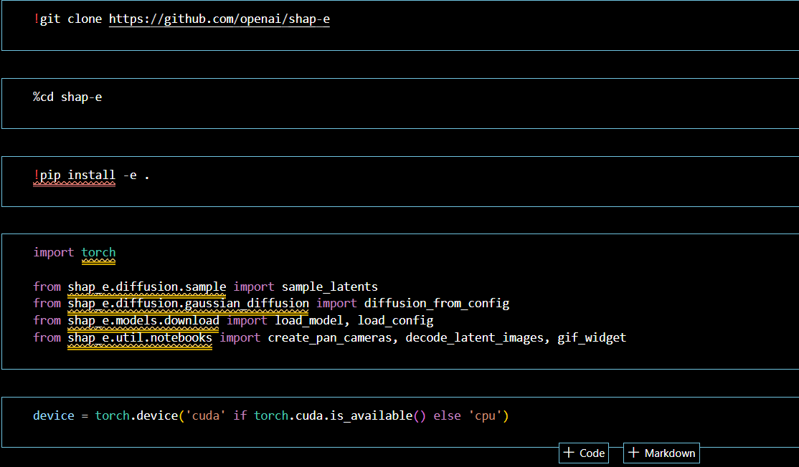
Implementation
Department of Artificial Intelligence and Machine Learning www.Cambridge.edu.in

Slide 13
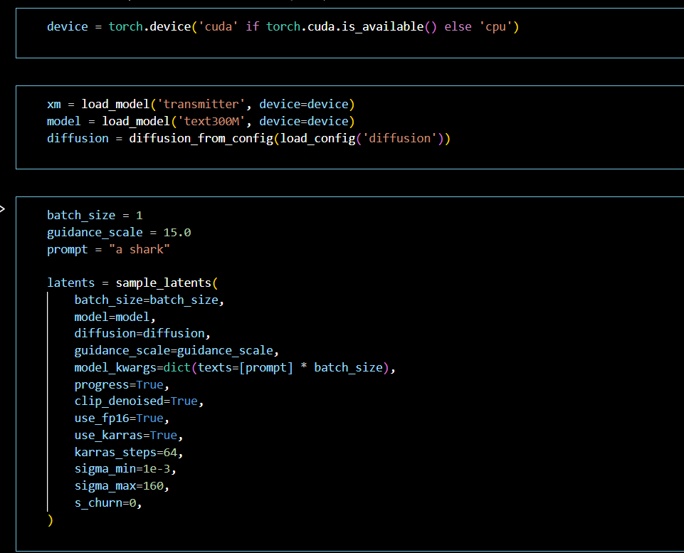
Implementation
Department of Artificial Intelligence and Machine Learning www.Cambridge.edu.in

Slide 14
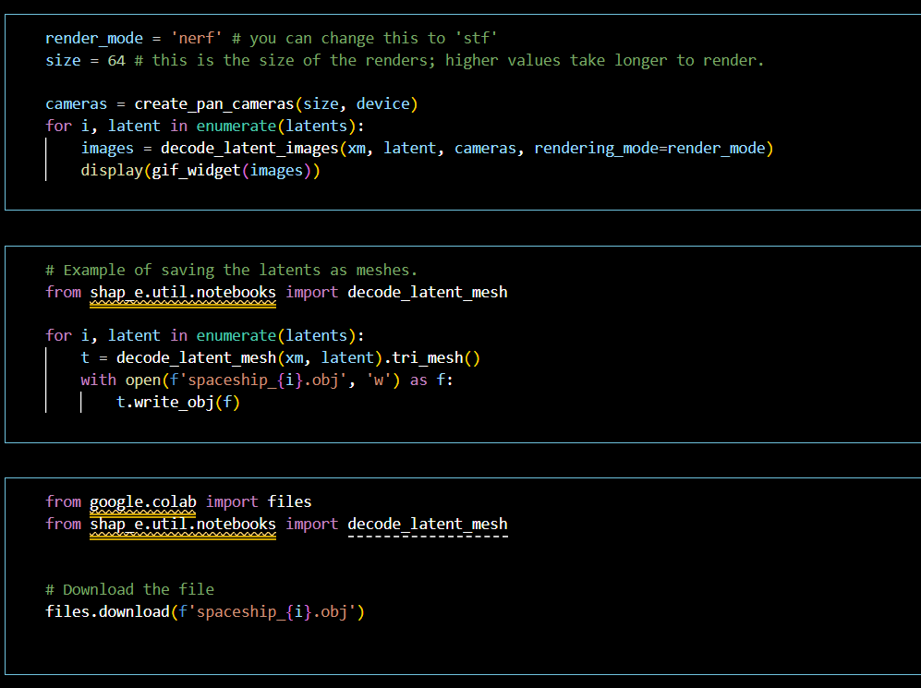
Implementation
Department of Artificial Intelligence and Machine Learning www.Cambridge.edu.in

Slide 15
Results :
High-quality shape generation
Examples of generated shapes
Comparison with other methods
Quantitative metrics: Accuracy, computational efficiency
Qualitative assessment: Visual fidelity, diversity of shapes
Department of Artificial Intelligence and Machine Learning www.Cambridge.edu.in

Slide 16
Conclusion
Shapegenai project effectively generates and understands 3D shapes
Outperforms traditional methods in both quality and efficiency
Potential to revolutionize various industries requiring 3D modeling
Department of Artificial Intelligence and Machine Learning www.Cambridge.edu.in

Slide 17
Future Work
Potential Improvements
Refinement of the model architecture
Expansion of the training dataset
Enhanced capability for real-time shape generation
New Applications
Integration with VR/AR technologies
Use in automated design and manufacturing
Extension to other forms of content generation (e.g., textures, animations)
Department of Artificial Intelligence and Machine Learning www.Cambridge.edu.in

Slide 18
References
Transformer Models:
Vaswani, A., et al. "Attention is All You Need." (2017).
Vaswani et al. Paper
3D Shape Generation:
Wu, J., et al. "Learning a Probabilistic Latent Space of Object Shapes via 3D Generative-Adversarial Modeling." (2016).
Wu et al. Paper
Wu, Z., et al. "3D ShapeNets: A Deep Representation for Volumetric Shapes." (2015).
Wu et al. Paper
Qi, C. R., et al. "PointNet: Deep Learning on Point Sets for 3D Classification and Segmentation." (2017).
Qi et al. Paper
Wang, N., et al. "Pixel2Mesh: Generating 3D Mesh Models from Single RGB Images." (2018).
Wang et al. Paper
Park, J. J., et al. "DeepSDF: Learning Continuous Signed Distance Functions for Shape Representation." (2019).
Park et al. Paper
Shap-E GitHub Repository:
OpenAI. "Shap-E: Generating and Understanding Shapes with AI." (2024).
Shap-E GitHub
Department of Artificial Intelligence and Machine Learning www.Cambridge.edu.in

Slide 19
THANK YOU
Department of Artificial Intelligence and Machine Learning www.Cambridge.edu.in

